Slide 1




Cincinnati’s GIS-based Customer Service Request System:
15 Years of Success
Alexandria Horne & Joshua Murphy
Senior Computer Programming Analysts Cincinnati Area Geographic Information System
September 7, 2017

Slide 2


Presentation Outline
Introduction to CAGIS
Customer Service Request (CSR) System
• Introduction
History
Key Features
GIS Integration
System Architecture
Recent System Enhancements
Results and Metrics
Future Enhancements

Slide 3


INTRODUCTION TO CAGIS

Slide 4
What is CAGIS?
Cincinnati
Area
Geographic
Information
System
CAGIS was founded in 1986 as a shared-services organization that provides services and solutions, integrated with land and infrastructure information, to its enterprise members.

Slide 5
The CAGIS Mission:
Support mission critical day-to-day operations by providing comprehensive, coordinated services and solutions related to:
Permitting
Licensing
Inspections
Code Enforcement
Planning
Zoning
Land and Infrastructure Asset Management

Slide 6
Organizations Supported by CAGIS
City of Cincinnati Agencies
Transportation & Engineering Buildings & Inspections Community Development Public Services Health Parks Fire Police Enterprise Services Law - Real Estate Economic Development Office of the City Manager Office of the Mayor City 911 City Council Members
Hamilton County Agencies
County Engineer Planning & Development Public Health District County 911 Emergency Management Soil & Water Conservation District County Auditor County Administrator County Board of Commissioners County Sheriff County Prosecutor Board of Elections
Utilities
Greater Cincinnati Water Works Metropolitan Sewer District Storm Water Maintenance Utility Duke Energy Hamilton County Storm Water District
Communities
Anderson Township Colerain Township Springfield Township Sycamore Township City of Blue Ash City of Forest Park City of Montgomery City of Norwood Village of Fairfax Village of Indian Hill Village of Lincoln Heights Village of Mariemont Village of Lockland
Non-Profit Members
Cincinnati Public Schools Metropolitan Housing Authority SORTA Xavier University Hamilton County Development Port Authority of Cincinnati Hamilton County Park Board
Private
Inspection Bureau Inc. National Inspection Company

Slide 7
CAGIS Key Functions
Workflow/Permitting Automation
Enterprise-level GIS Data (both internal and public version)
Customer Service Response System
Construction Coordination System
Pavement Asset Management
Public Safety Applications (Firebird, etc.)
Field Applications – Inspections, Asset Inventory, Mobile GIS
Management Dashboards and Reports
Open Data and Metrics
CAGIS.org

Slide 8
CUSTOMER SERVICE REQUEST SYSTEM (CSR)

Slide 9
CSR is…
An innovative customer service request system that allows for enterprise-wide management of service requests and customer interaction.
Initially released in 2002.
Created and supported by CAGIS.
Initially created for the City of Cincinnati. However, several other jurisdictions in Hamilton County have now requested the application.
The system provides City employees with the tools they need to effectively manage a service request throughout its entire “life,” from its initial intake to the final outcome.

Slide 10
CSR’s History
In early 2002, Cincinnati City Council realized that the city was experiencing significant problems in its customer service delivery.
Council requested a report on the feasibility of a single interdepartmental customer service request system for essential city services.
By late 2002, City Council had approved implementation of a Customer Service Request (CSR) system to improve the coordination and management of services provided to City residents, companies, workers, and visitors and between City agencies.
Decision was made to develop the system in-house (CAGIS), to ensure tight integration with the city’s enterprise system.

Slide 11
Main Goals of CSR
During initial project development, three main goals were identified:
View all city work at any particular location.
2. Enable an organization-wide view of service requests and responses so we can better identify our needs to invest in department responses and community initiatives.
3. Create a system that improves our intra and inter-department coordination in meeting community goals and service needs.

Slide 12
CSR’s Key Features
Automation of the intake and routing of service requests and the resulting departmental activities in one coordinated system.
Tracking of service requests from the public and internal requests from one City agency to another.
Integration of these service requests and activities with the existing citywide database of automated workflows (Accela Permits Plus) and the Cincinnati Area Geographic Information System (CAGIS).
Online “dynamic knowledge base” of telephone numbers, department facts, city and regional events, reference information, tips and “how-to” facts searchable by topic, category and keyword.

Slide 13
CSR’s Key Features
Automatic work-order dispatching through existing Work Order systems.
Computer and text message capabilities for field personnel.
Automated creation of correspondence, notices, e-mail messages, etc.
Management tools including custom reports and maps.
GIS Integration…

Slide 14
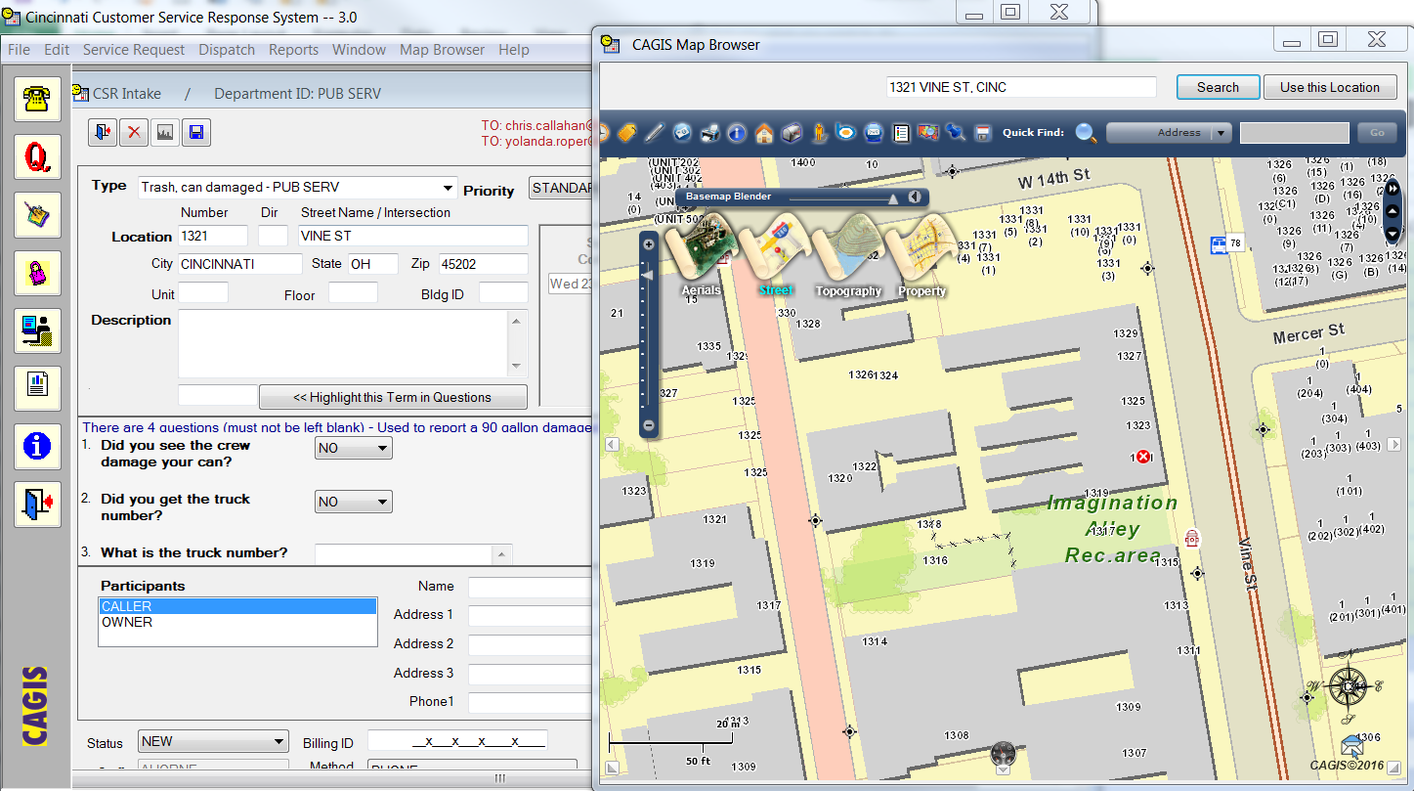
GIS Integration
The CSR system relies on two-way communication between the application and the GIS to create, manage and resolve service requests.

Slide 15
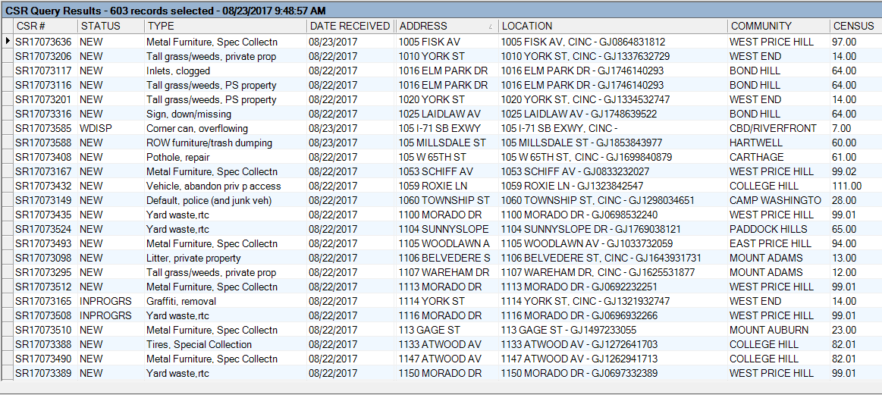
GIS Integration

Slide 16
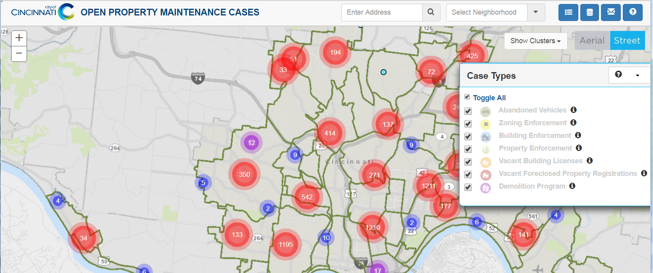
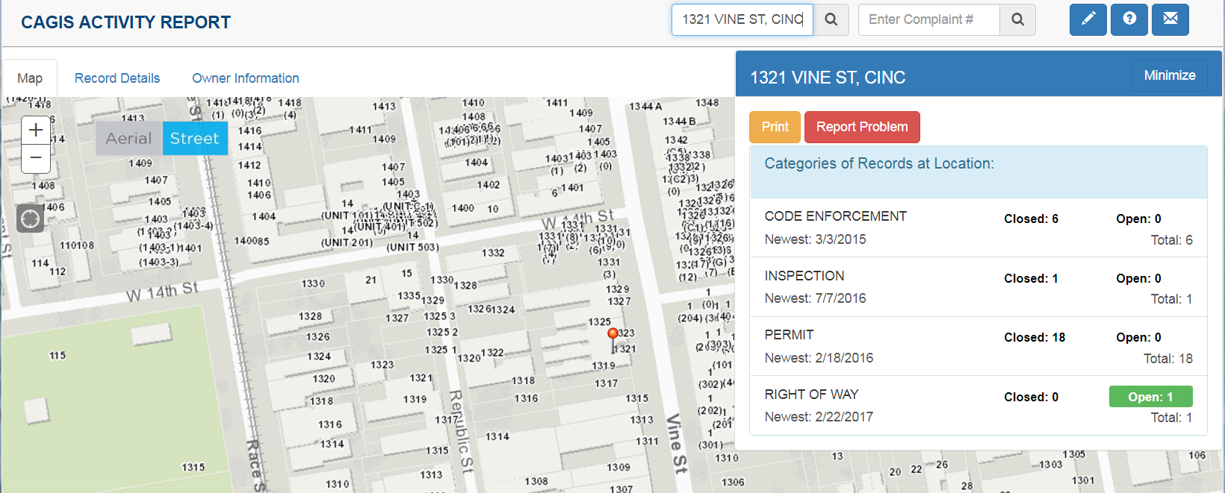
GIS Integration
Open Property Maintenance Cases
Property Activity Report

Slide 17







Service Request Submission
Public
Call Center CSR Desktop
Website 5916000.com
E-mail
Mobile App
Fix It Cincy!
CAGIS Enterprise System
CSR Administrator

Slide 18



System Architecture
PUBLIC
Property Activity & Property Maintenance Websites
CSR Online
Call Center
Fix it Cincy!
Service Requests
CITY STAFF
CAGIS STAFF
GIS Database
Permits Database
Document Management System
CSR Desktop
CSR Administrator

Slide 19
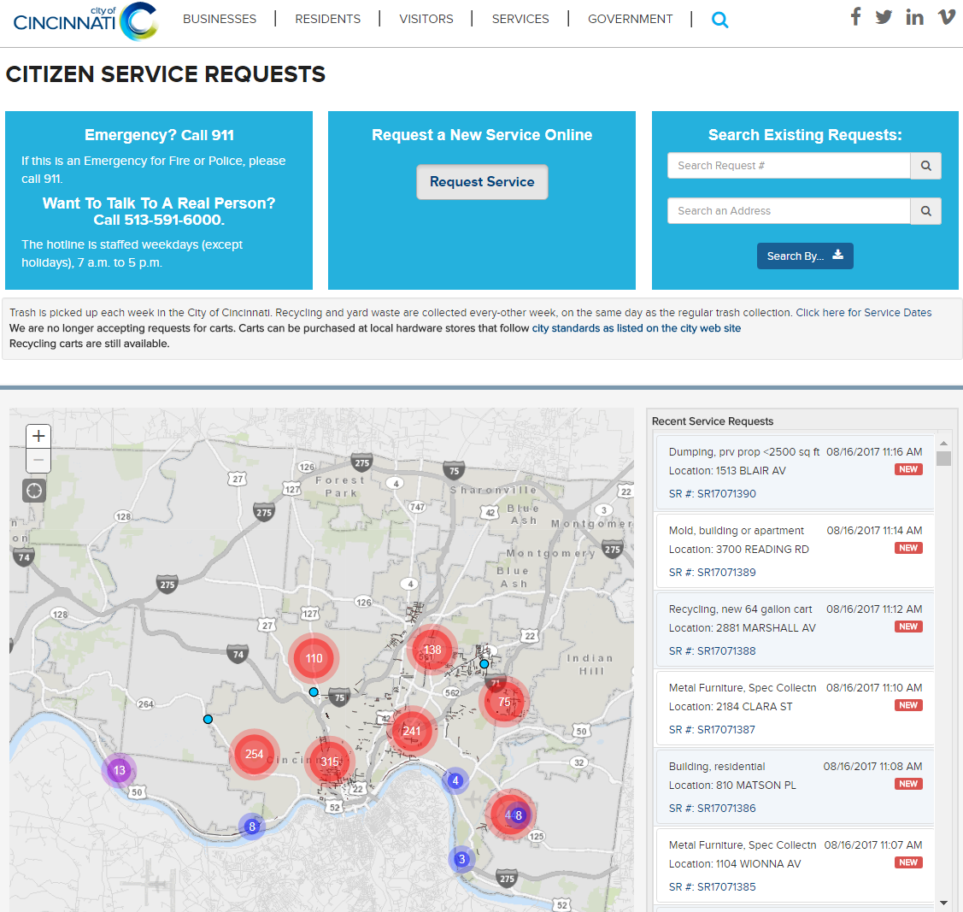
CSR Online
5916000.com

Slide 20
Customer Photo Uploads

Slide 21
Service Request Processing
Service request generated
Routed to correct city department
Action taken by city department
Record marked as complete by staff
E-mail sent to user

Slide 22
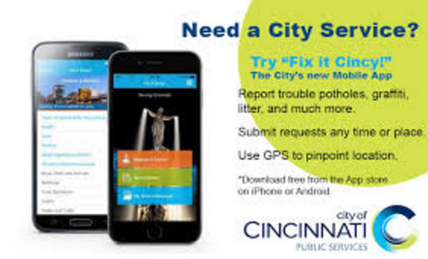

'Fix it Cincy!' Mobile App
Your City Services... On The Go!

Slide 23
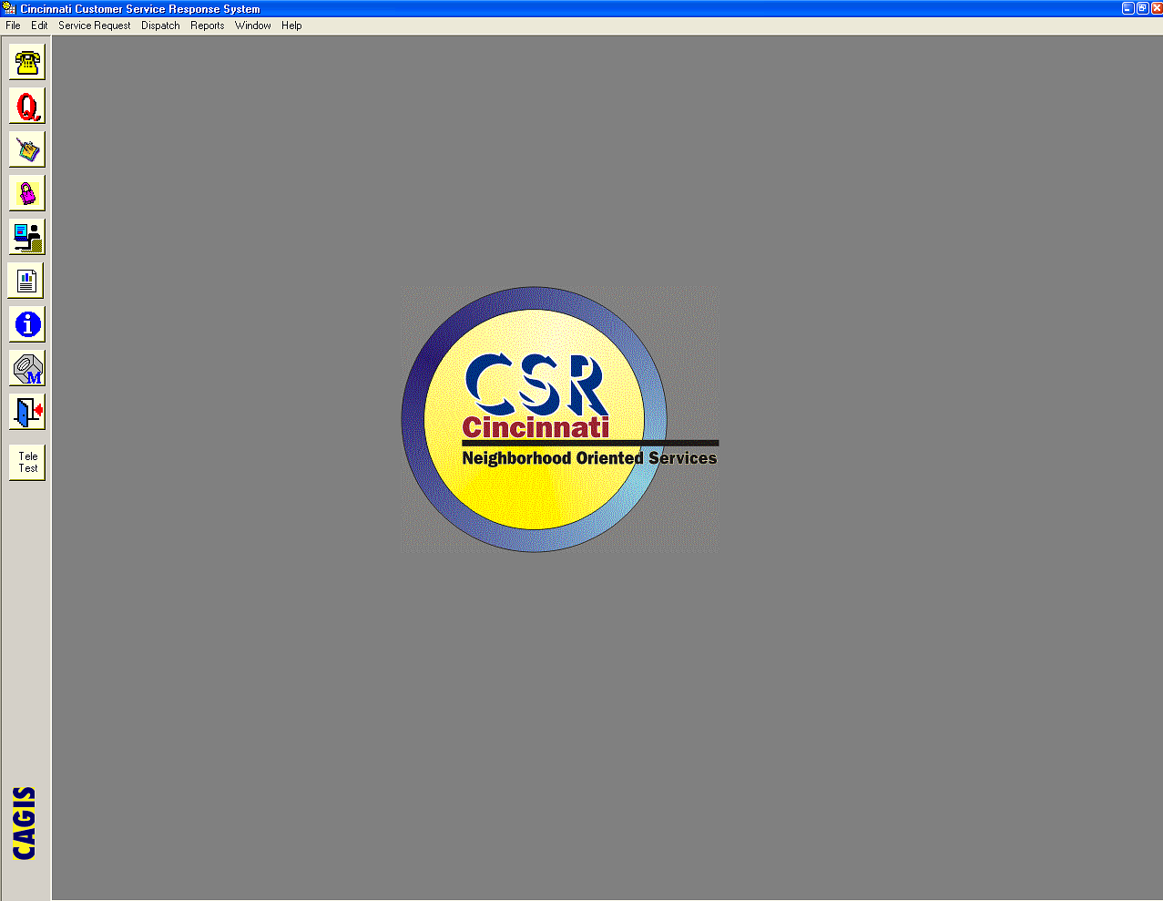
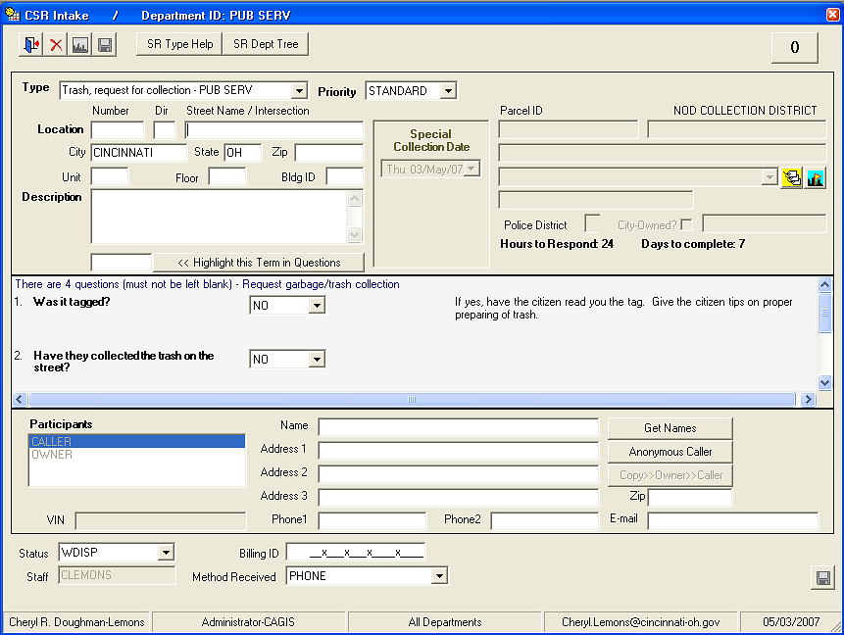
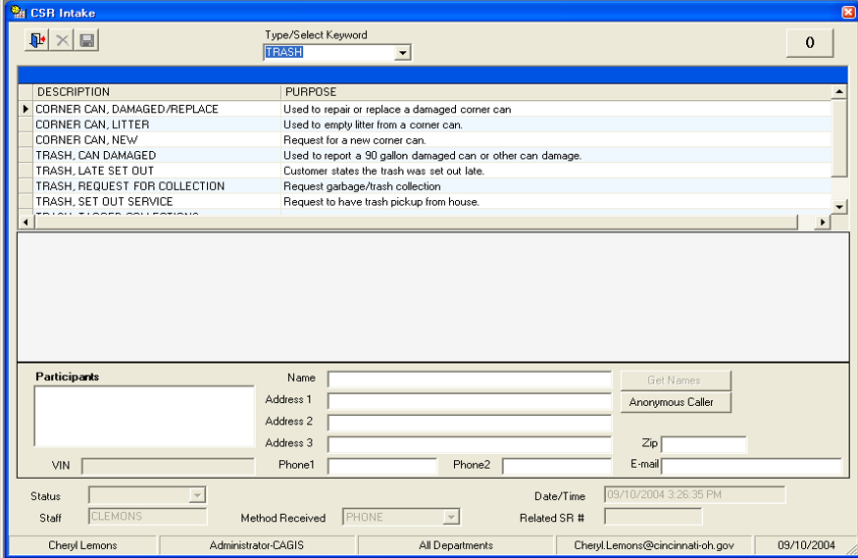
CSR Desktop Service Request Intake

Slide 24
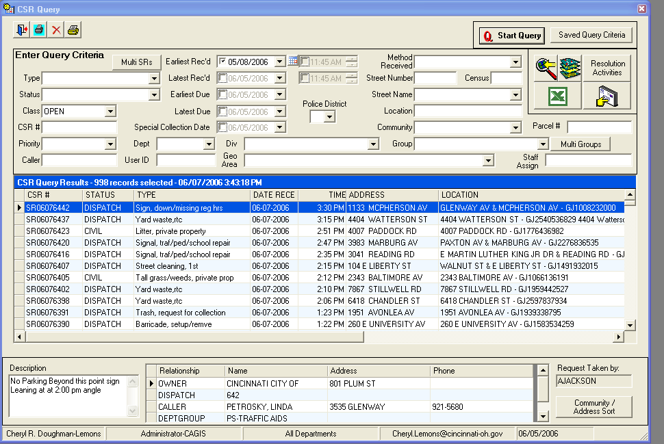
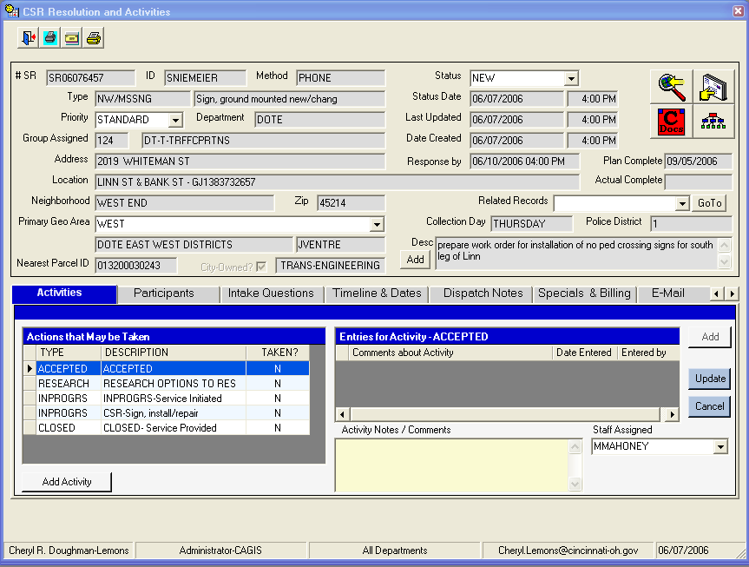
CSR Desktop Service Request Query

Slide 25
Service Request Classification
Department
Group
Service Request Type
Priority
Method Received
Public Service
Health
Sewer District
Transportation
Law
Water Works
Building
Police
Parks
Recreation
Pubic Service:
Winter operations
Street cleaning
Recycling
Special collections
Asphalt
Graffiti
Yard waste
Special collection – furniture
Special collection – tires
Trash, request for collection
Trash, early set out
Pothole
Dead animal
Slippery streets
Standard Priority
Hazardous
Emergency
Phone
Mail
City Department
Internet
Radio

Slide 26
System Component - CSR Administrator
The CSR Administrator allows departments to create service requests and groups, enter
the questions they feel will best identify the problem as theirs and provide the
information needed for mobilization, and create the activities that must be accomplished
to effect resolution.
• Create departmental groups
• Register members by assigning groups and security profiles
• Create and configure service request types
• The department that a user is permitted to manage will be automatically set in the
configuration manager, based on departmental business rules.
• Create work order linkages to specific service request actions.

Slide 27
RECENT SYSTEM ENHANCEMENTS

Slide 28
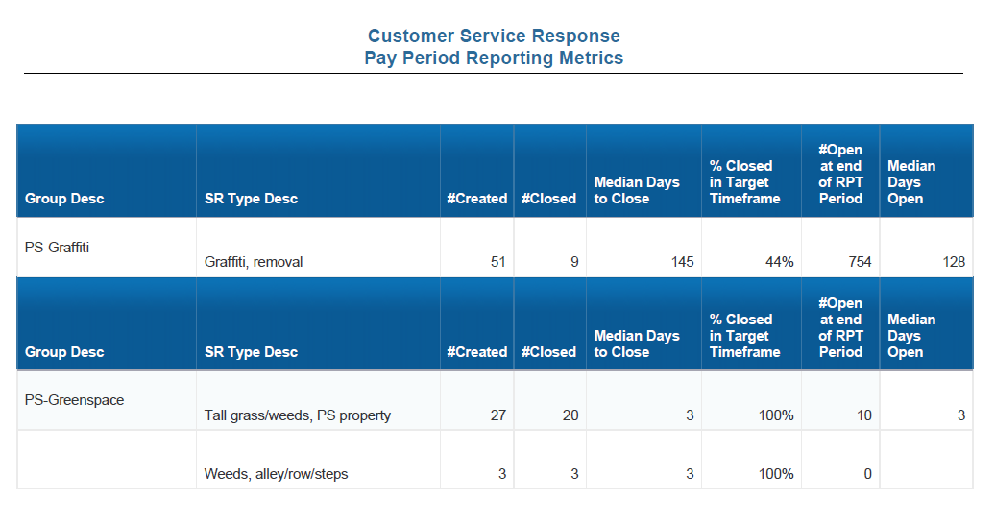
Enhancement: Scheduled and on-demand Reports for Staff

Slide 29
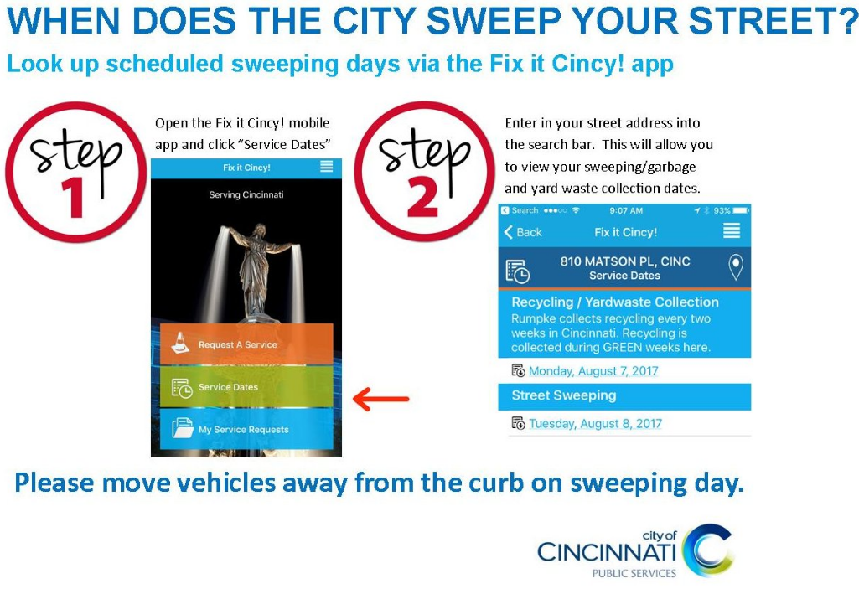
Enhancement: Increased Marketing

Slide 30

Enhancement: Increased Marketing

Slide 31

Enhancement: Increased Marketing

Slide 32
Enhancement: “Fix it Cincy!” Mobile App
Released October 2015

Slide 33
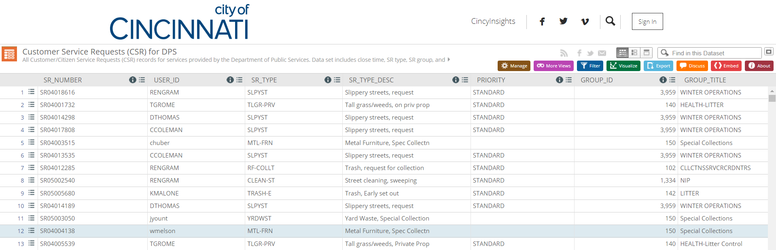
Enhancement: Transparency via Open Data Cincinnati
Open Data - Service Requests

Slide 34
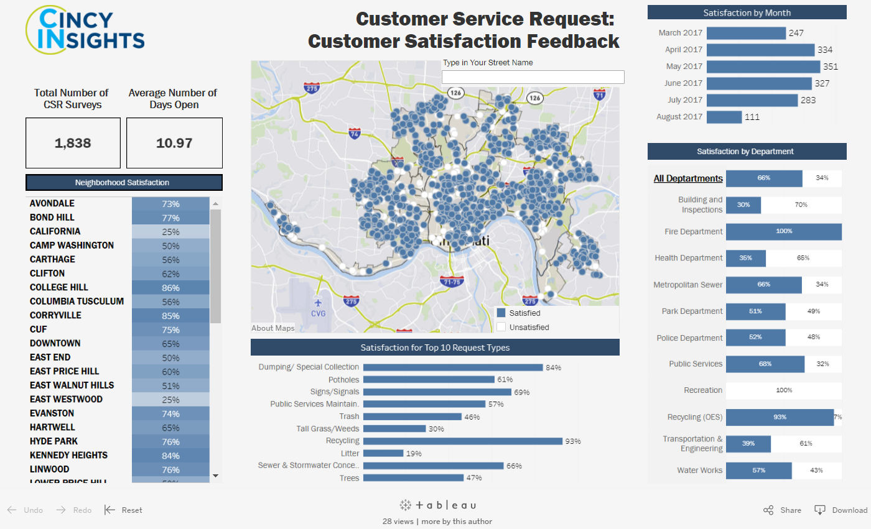
Enhancement: Cincy Insights
8/15/2016 to 8/15/2017

Slide 35
RESULTS AND METRICS

Slide 36
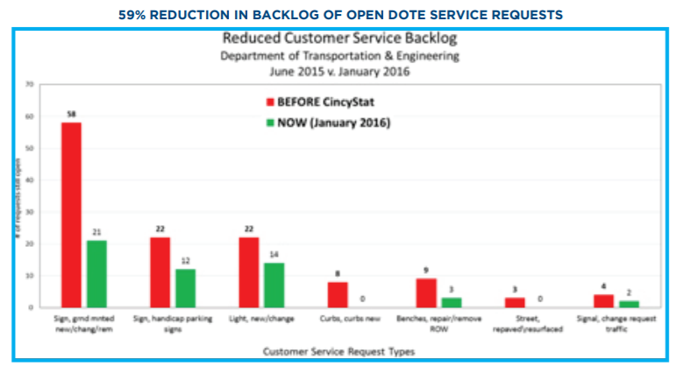
Result: 59% Reduction in Backlog (DOTE)

Slide 37
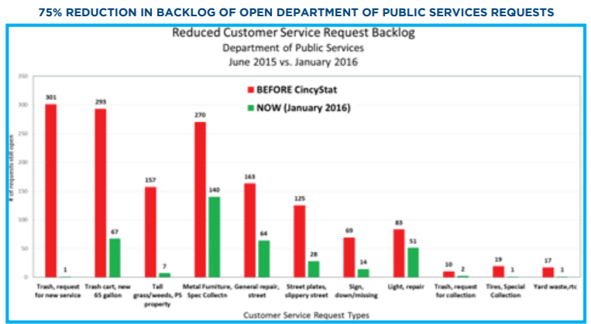
Result: 75% Reduction in Backlog (DPS)

Slide 38
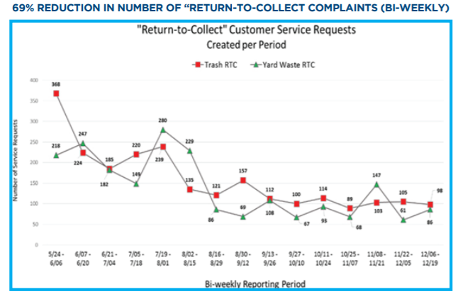
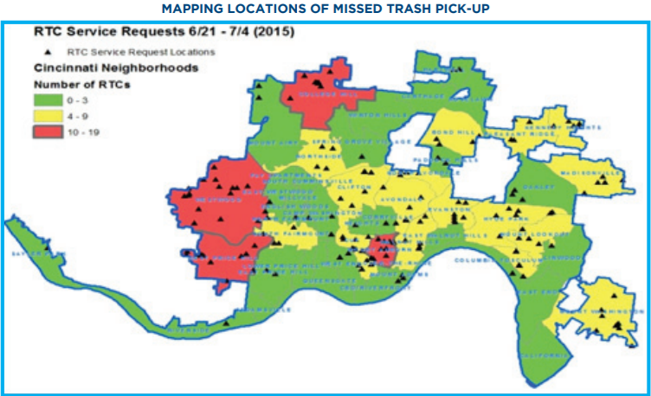
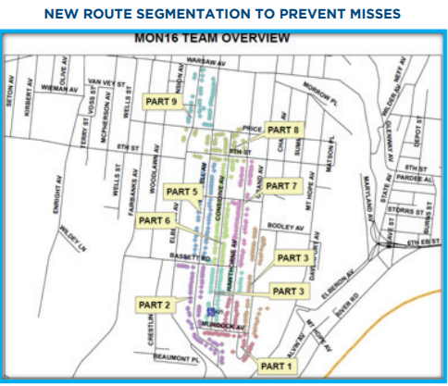
Result: Improved Trash Collection

Slide 39
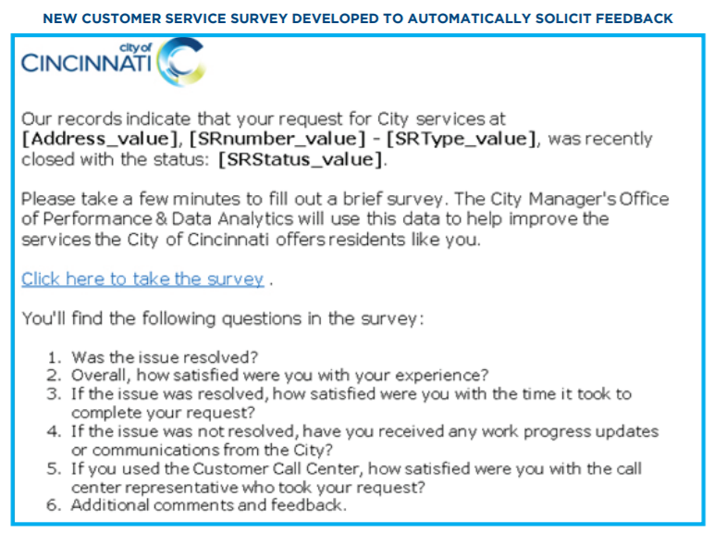
Enhancement: Customer Service Survey

Slide 40
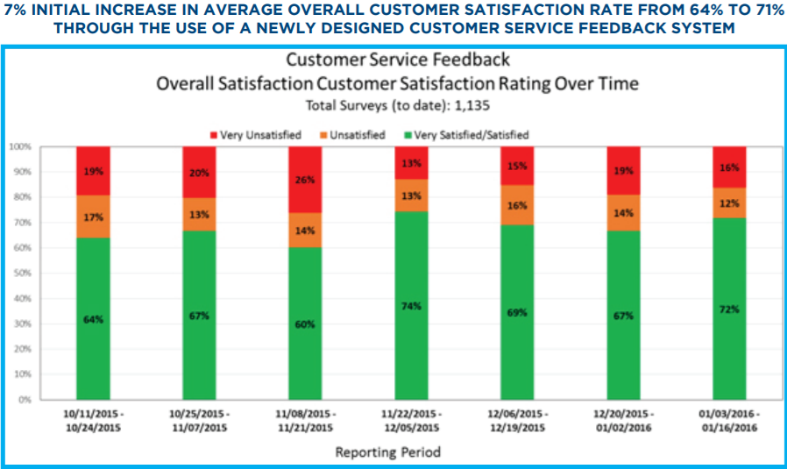
Result: Increase in Customer Satisfaction

Slide 41
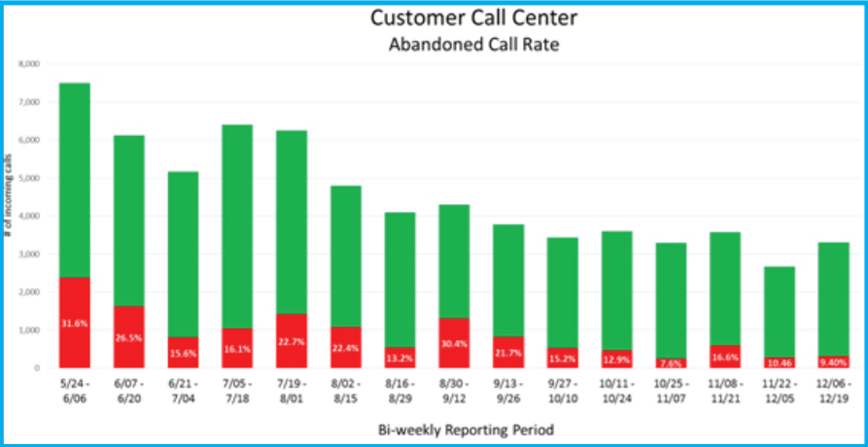
Result: Decrease in Abandoned Calls

Slide 42
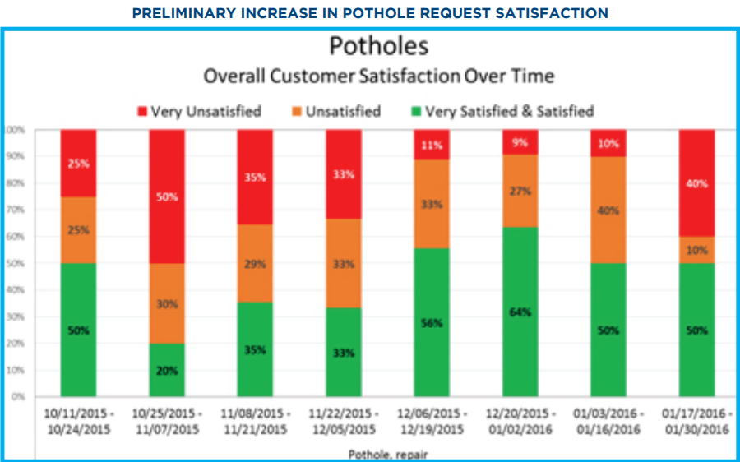
Result: Increase in Customer Satisfaction (Potholes Requests)

Slide 43
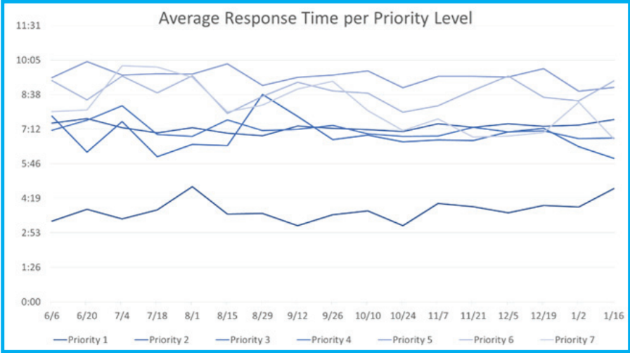
Result: Decrease in Average Response Time

Slide 44
FUTURE ENHANCEMENTS

Slide 45
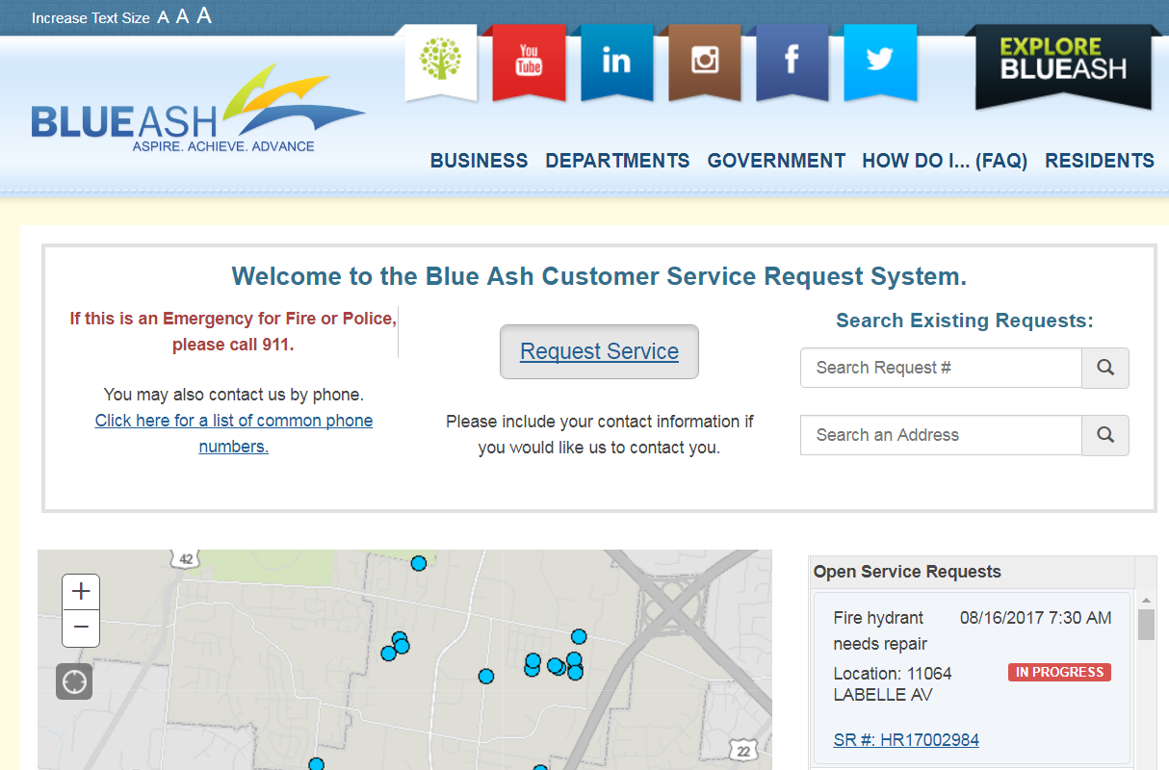
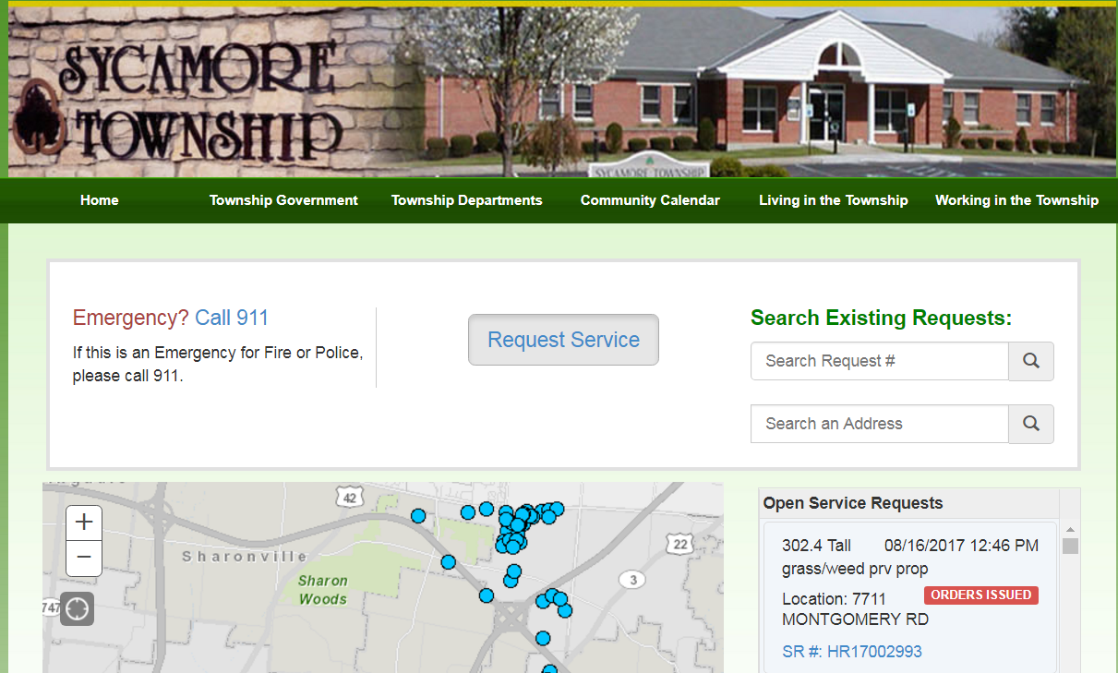
CSR – Not Just for Cincinnati (anymore)

Slide 46
Future Enhancements
Supporting projects underway include the automation and enterprise tracking of city-owned property and right-of-way, inventory of poles and signage, and improvement of data to link requests to infrastructure features.
Continue to rollout CSR systems for other communities.

Slide 47
Thank you for your time!
Are there any questions?
Alexandria Horne
alexandria.horne@cincinnati-oh.gov
Joshua Murphy
Joshua.murphy@cincinnati-oh.gov

